Slide 1
EXT2 File System – Part 2
CptS 360 Systems Programming
School of Electrical Engineering and Computer Science
Washington State University
Hassan Ghasemzadeh (hassan.ghasemzadeh@wsu.edu)

Slide 2
Topics
EXT2 file system traversal
Organization of an EXT2 file system
File system levels for an example EXT2 file system

Slide 3
EXT2 Traversal

Slide 4
File system traverse
Why?
An important step toward implementing a file system is to be able to traverse the file system
What is file system traverse?
Given a pathname for a ﬁle (e.g., /a/b/c), goal of traverse is to navigate through the file system to find the file
How?
Finding a file relies on ﬁnding its inode
Traversal algorithm
In the following we discuss an overall algorithm for file system traversal

Slide 5
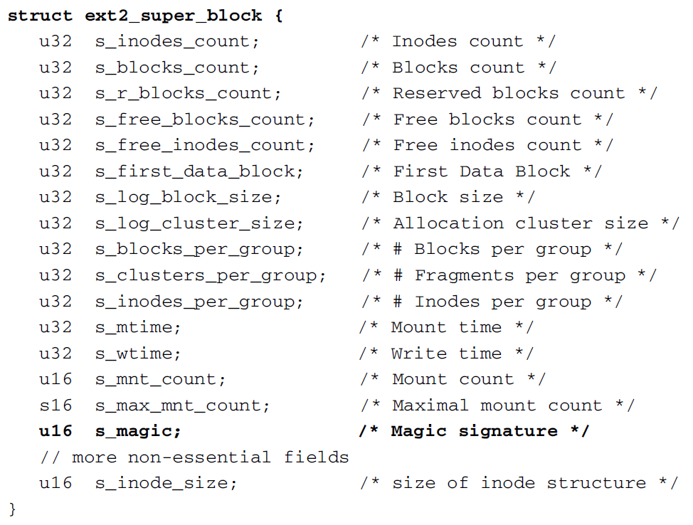
Traversal algorithm (step #1)
Step #1: Check magic number, s_magic filed in superblock to make sure that it is 0xEF53
This step verifies that the given file system is EXT2

Slide 6
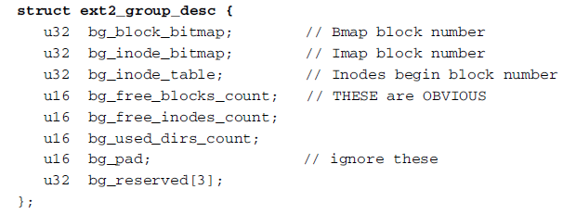
Traversal algorithm (step #2)
from superblock
Step #2:
Read in the group descriptor block (1 + s_ﬁrst_data_block) to access the group 0 descriptor
From the group descriptor’s bg_inode_table entry, ﬁnd inodes begin block number, call it InodesBeginBlock

Slide 7
Traversal algorithm (step #3 and step #4)
Step #3
Read in InodeBeginBlock to get inode of directory /
Note that / has an inode of 2
Step #4
Tokenize pathname into component strings
Example, for pathname=/a/b/c, component strings are “a”, “b”, “c” and n=3 (there are 3 components)
Let components be name[0], name[1], .., name[n-1]

Slide 8
Traversal algorithm (step #5)
Step #5:
Start from root inode, look for name[0] in data blocks
For simplicity, in this example, assume number of entries in a directory is small so that an inode only has 12 direct data blocks
Search the 12 (non-zero) direct blocks for name[0]
Data block of a directory inode contains dir_entry structures:
NAME is a sequence of name_len chars without a terminating NULL
For each data block, read block into memory and use a dir_entry *dp to point at the loaded data block.
Then use name_len to extract NAME as a string and compare it with name[0]
If they do not match, step to next dir_entry using

Slide 9
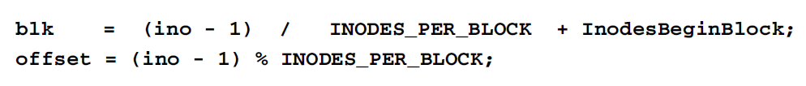
Traversal algorithm (step #6)
Step #6:
Use inode number, ino, to locate corresponding inode
ino counts from 1
Compute disk block containing inode and its offset in that block
Read in inode of /a, from which we can determine whether it is a directory or not
If /a is not a directory, there cannot be /a/b, so search fails
If it is a directory and there are more components to search, continue for next component, name[1]

Slide 10
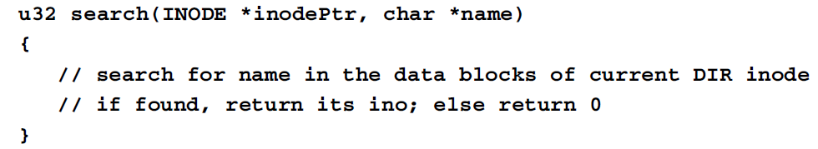
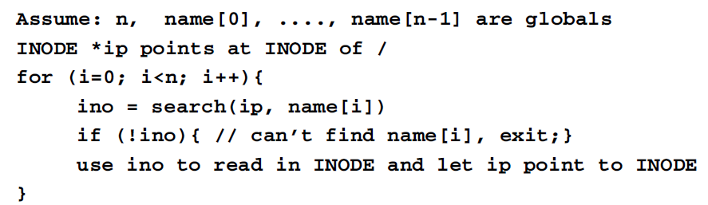
Search function for traversal
Steps #5 and #6 repeat for different string components
We can write a search function for use in these steps
How to use the search() function?

Slide 11
EXT2 File System Organization

Slide 12
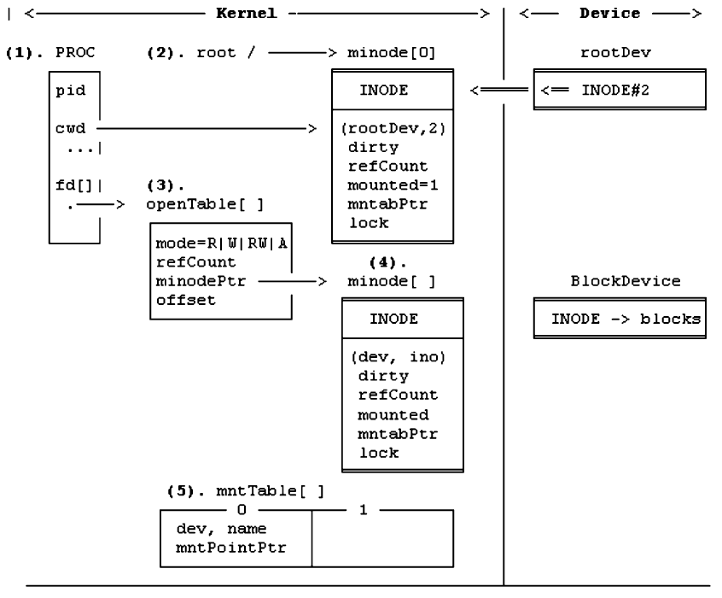
Organization of a file system

Slide 13
(1) PROC
File operations occur at the request of an executing process
PROC refers to PROC structure of running process
cwd: each PROC has a cwd (pointing to the in-memory inode of PROC’s current working directory)
pid: process id
fd[]: an array of ﬁle descriptors pointing to opened ﬁles

Slide 14
(2) Mount root
Root pointer points to in-memory root inode
Root device must be a valid EXT2 ﬁle system
Root inode (inode #2) of root device is loaded into memory as root (/)
This operation is known as “mount root ﬁle system”

Slide 15
(3) OpenTable entry
When a process opens a ﬁle, an entry of PROC’s fd array points to an openTable
OpenTable points to in-memory inode opened ﬁle

Slide 16
(4) In-memory inode
minode
Whenever a ﬁle is needed, its inode is loaded into a minode slot for reference
Because inodes are unique, only one copy of each inode can be in memory at any time
(dev,ino)
identifies where inode came from
This information is needed for writing inode back to disk if modiﬁed

Slide 17
(4) In-memory inode (cont.)
refCount
It records number of processes using minode
dirty
Indicates whether inode has been modiﬁed
mounted
Indicates if inode has been mounted
mntabPtr
Points to mount table entry of mounted ﬁle system
lock
Ensures in-memory inode is accessed by one process at a time

Slide 18
(5) mntTable
mntTable is a table of mounted ﬁle systems
Entries in mount table record information about mounted ﬁle systems
dev
mounted ﬁle system device number
mntPointPtr
In in-memory inode of mount point, mounted ﬂag is turned on and mntabPtr points to mount table entry
In mount table entry, mntPointPtr points back to the in-memory inode of mount point
These are doubly-linked pointers
Used to cross mount points when traversing ﬁle system tree

Slide 19
File System Levels

Slide 20
File system levels
Our ultimate goal in EXT2 file system topic is to implement a file system
To this end, we divide the file system into three levels
Level-1
Level-2
Level-3
Each level deals with a distinct part of ﬁle system
This makes the implementation process modular and easier to understand.

Slide 21
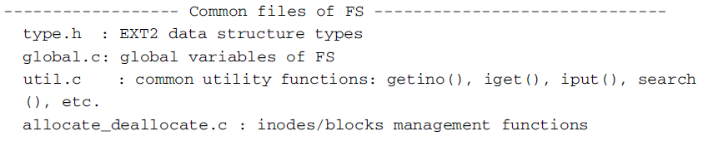
File system implementation common ‘files’
Before discussing file system levels, note that there are several files that are used in the file system directory for file system implementation
The ﬁles are organized as follows.

Slide 22
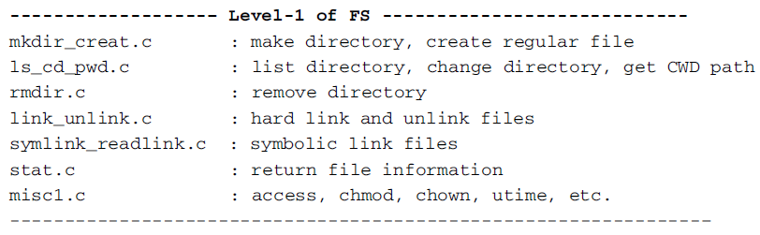
File system implementation level-1
Level-1 implements basic ﬁle system tree
It contains the following ﬁles
User command programs which use the level-1 FS functions include
mkdir, creat, mknod, rmdir, link, unlink, symlink, rm, ls, cd, pwd, etc.

Slide 23
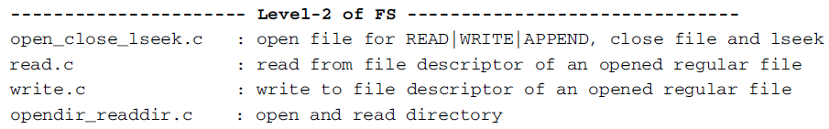
File system implementation level-2
Level-2 implements functions for reading/writing ﬁle contents.

Slide 24
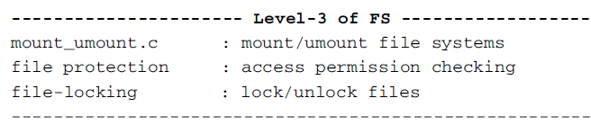
File system implementation level-3
Level-3 implements mount, umount ﬁle systems and ﬁle protection

